Slide 1
Depsy Variables

Slide 2
Package Matrix Variables - ID
Name of the package
0% missing
100% unique

Slide 3
Citations_harv
Number of times cited in Harvard literature
No packages were cited

Slide 4
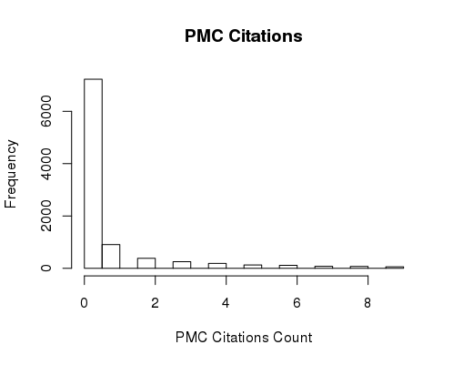
Citations_pmc
Number of times cited in Europe PMC, an archive of life science journal literature

Slide 5
Git_owner
Github user who owns the project
Out of 9810 packages, only 1283 distinct owners

Slide 6
Git_repo_name
Name of the repository for given project, in this case usually the same as package name
Out of 9810 packages, only 2295 distinct repo names

Slide 7
Host
Network that supports and hosts given package
All 9810 hosted by CRAN

Slide 8
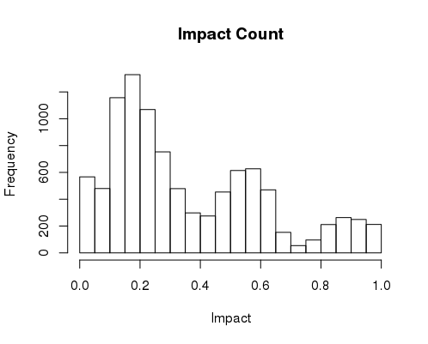
Impact
Not entirely sure how it’s calculated

Slide 9
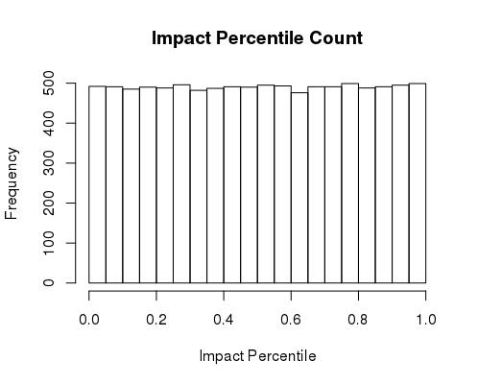
Impact_percentile
Somehow ties back to impact

Slide 10
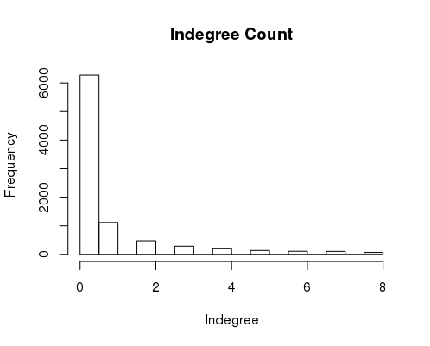
Indegree

Slide 11
Is_academic
Boolean determining whether package is meant for academia or not
Every single package is TRUE

Slide 12
Language
All are written in R

Slide 13
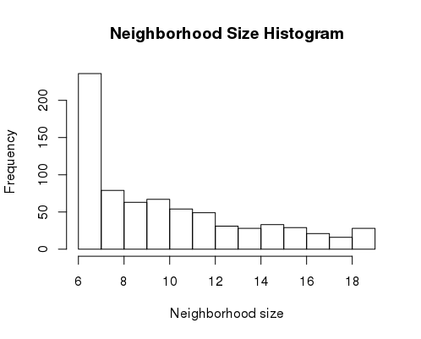
Neighborhood_size
How many packages depends on

Slide 14
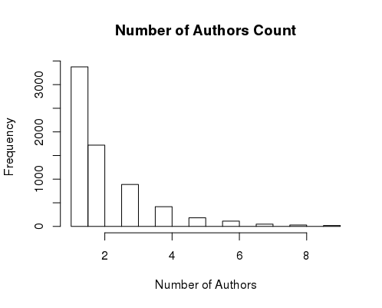
Number of Authors
Number of authors for a given package

Slide 15
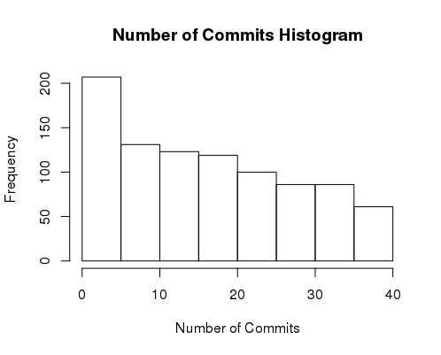
Number of Commits
Commit is when someone makes changes to Github code and submits it back to the repository on Github

Slide 16
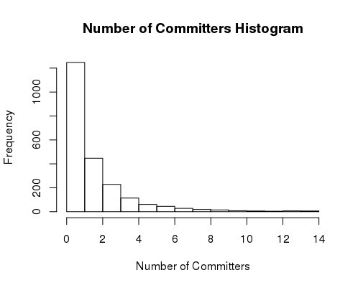
Number of Committers
Committer is someone that commits to a given project

Slide 17
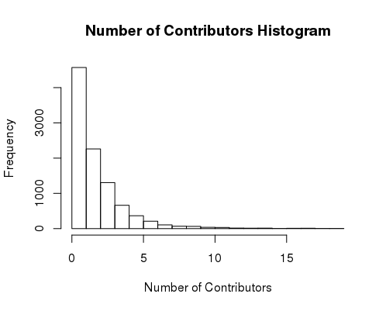
Number of Contributors

Slide 18
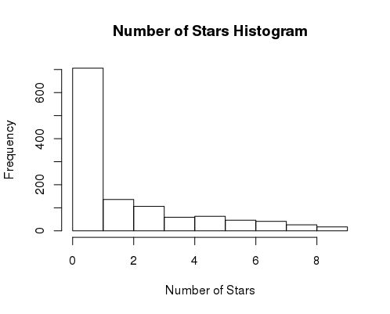
Number of Stars
Scrapes the number of stars from corresponding Git repository

Slide 19
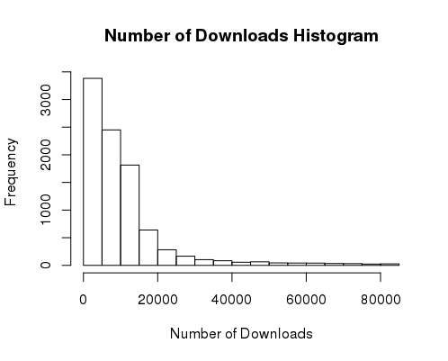
Number of Downloads

Slide 20
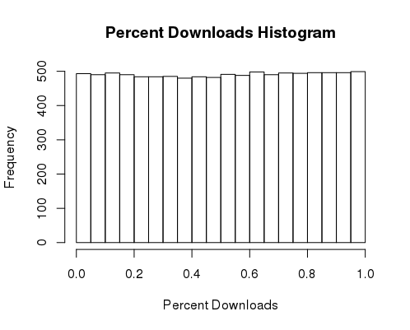
Percent Downloads

Slide 21
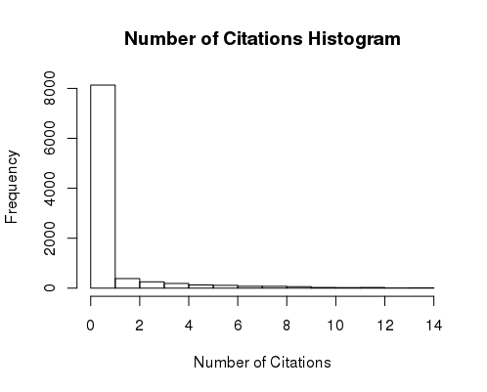
Number of Citations
Sum of PMC and Harvard citations

Slide 22
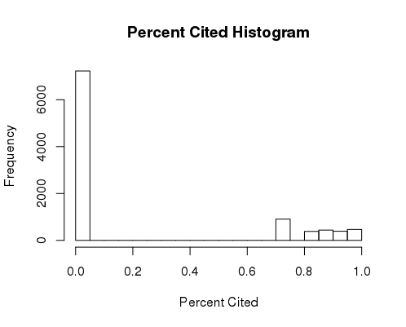
Percent Cited

Slide 23
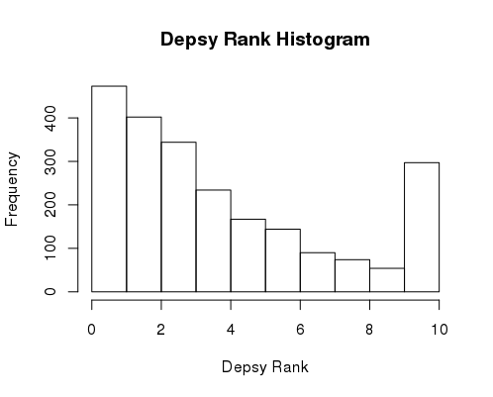
Depsy Rank

Slide 24
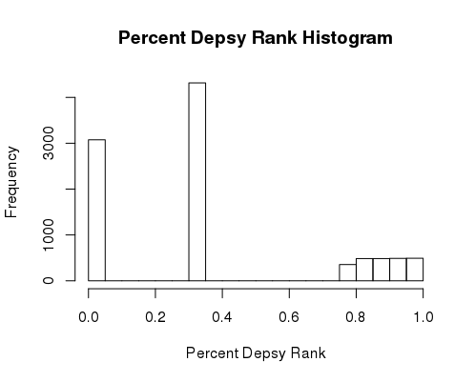
Percent Depsy Rank

Slide 25
Summary
Overview of every package
Every package had a summary

Slide 26
Contributor Matrix Variables - OSS Names
24,000 entries in contributor matrix, only 8,900 unique OSS names

Slide 27
Contributors
24,000 entries, 14,000 unique contributors

Slide 28
Git Logins
65% missing values
43% of the git logins are unique

Slide 29
ID’s
100% complete
65% of the ID’s are unique

Slide 30
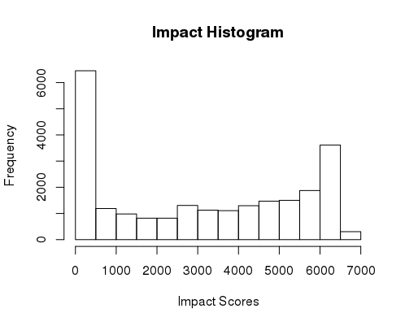
Impact Score

Slide 31
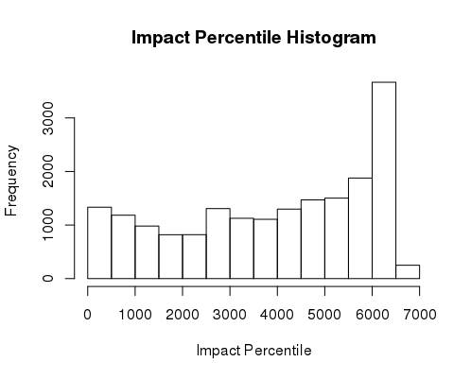
Impact Percentile

Slide 32
Is Organization
Boolean determining whether contributor is in an organization or not
Overwhelmingly false

Slide 33
Main Language
77% written in R, 23% written in Python

Slide 34
Person Name
5% missing
58% of the names are unique

Slide 35
Roles
1020 unique roles
70% of roles were “author(TRUE)”

Slide 36
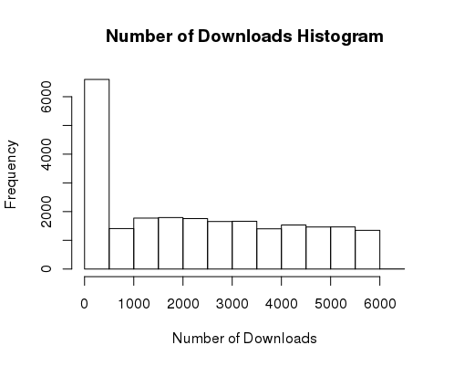
Number of Downloads

Slide 37
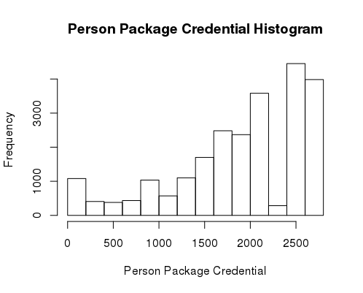
Person Package Credential

Slide 38
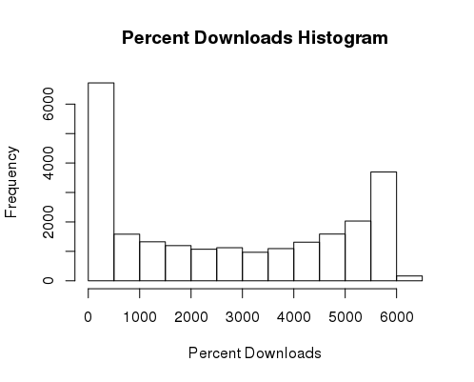
Percent Download

Slide 39
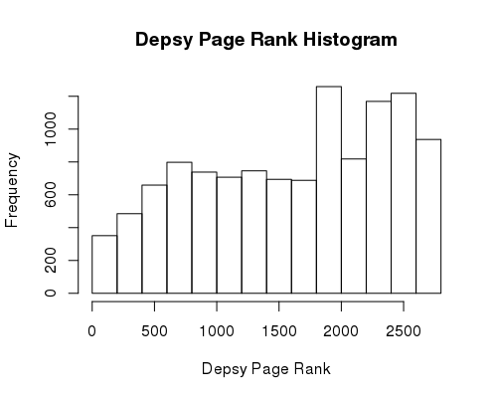
Depsy Page Rank

Slide 40
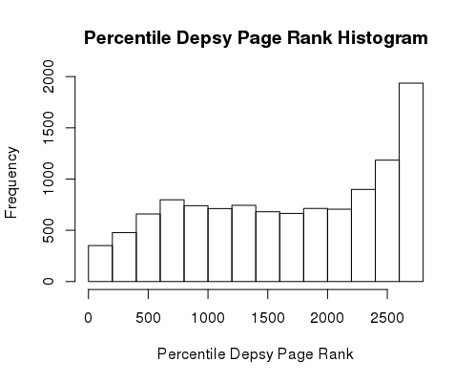
Percentile Depsy Page Rank

Slide 41
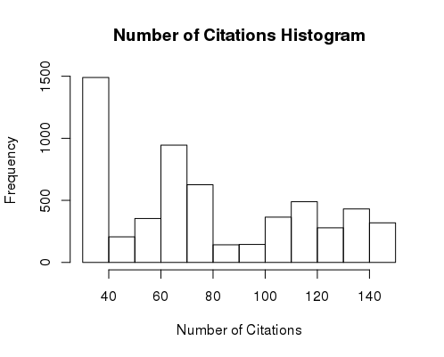
Number of Citations
65% of the contributors had zero citations

Slide 42
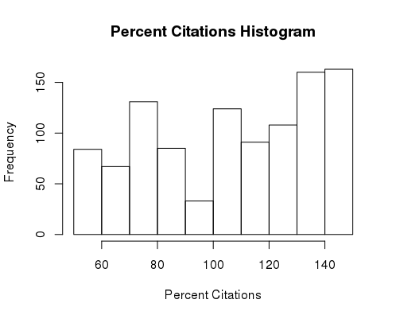
Percent Citations
No missing values
65% values are zeros

Slide 43
Depsy Dependency Network Nodes Variables - ID
100% complete and unique entries

Slide 44
Label and Timeset
Both variables are completely missing

Slide 45
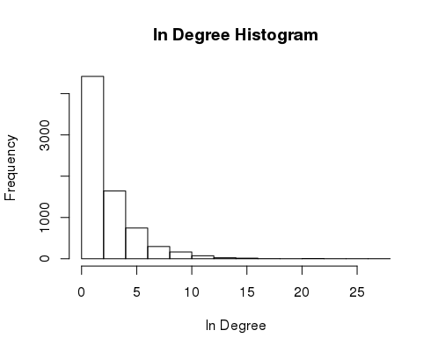
Indegree

Slide 46
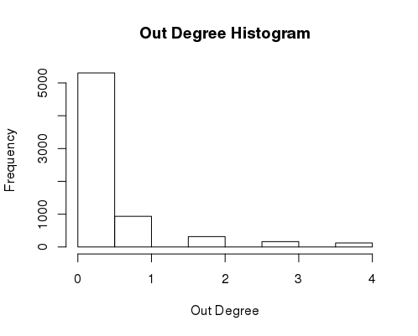
Out Degree

Slide 47
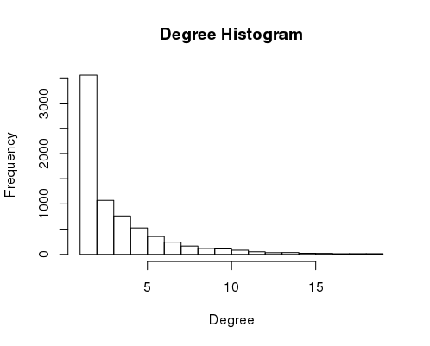
Degree
Sum of indegree and outdegree

Slide 48
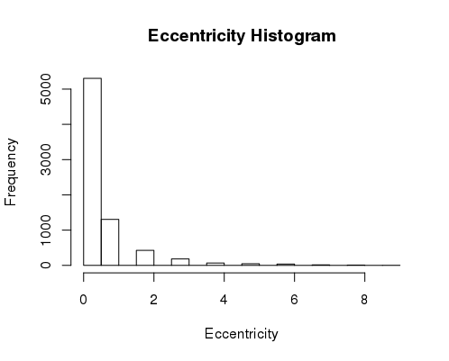
Eccentricity

Slide 49
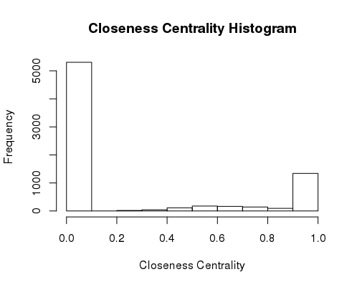
Closeness Centrality

Slide 50
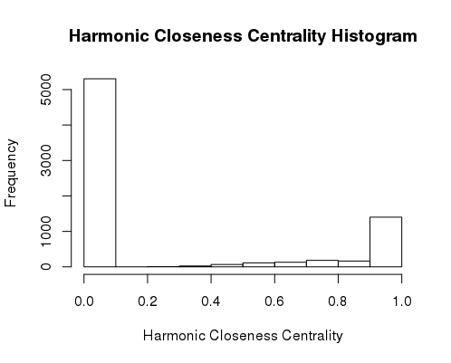
Harmonic Closeness Centrality

Slide 51
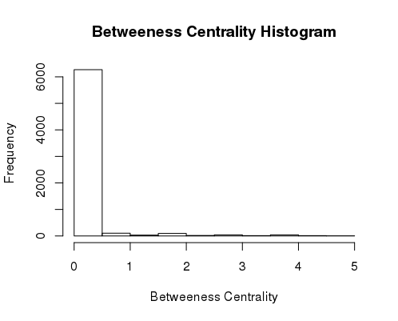
Betweenness Centrality

Slide 52
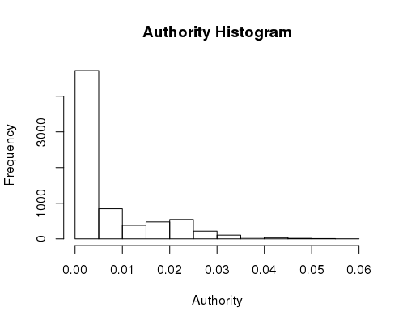
Authority

Slide 53
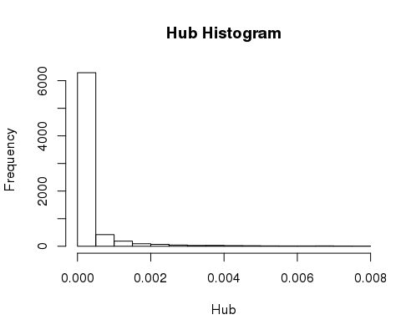
Hub

Slide 54
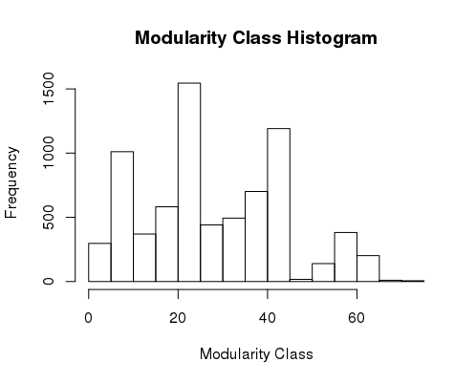
Modularity Class

Slide 55
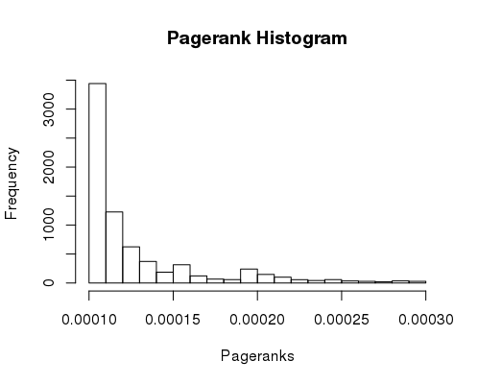
Pagerank

Slide 56
Component Number
98% of the entries were zero

Slide 57
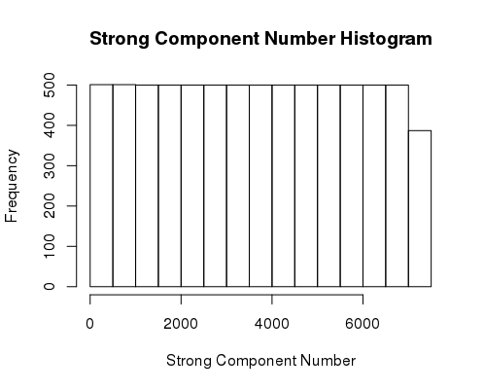
Strong Component Number
Could not find a good place to filter it

Slide 58
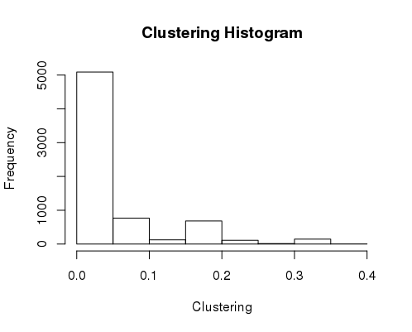
Clustering

Slide 59
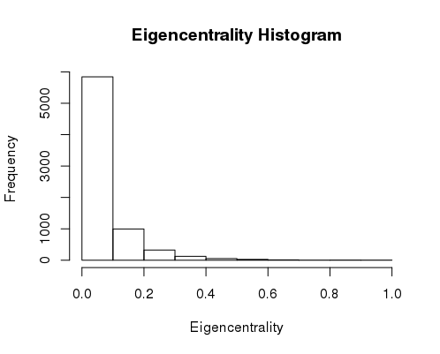
Eigencentrality

Slide 60
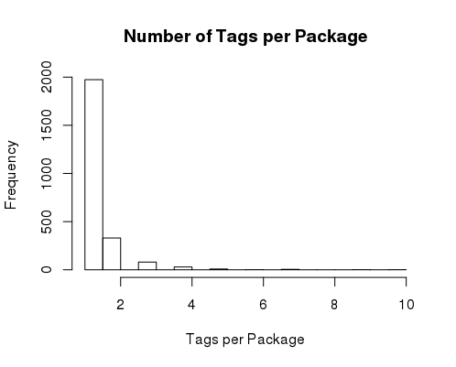
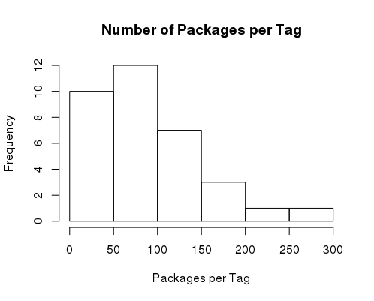
Tag Matrix
Average number of tags per package - 1.3 (34 total)
Average number of packages per tag - 90.8 (2429 total)
  Only 25% are represented in this matrix

Slide 61
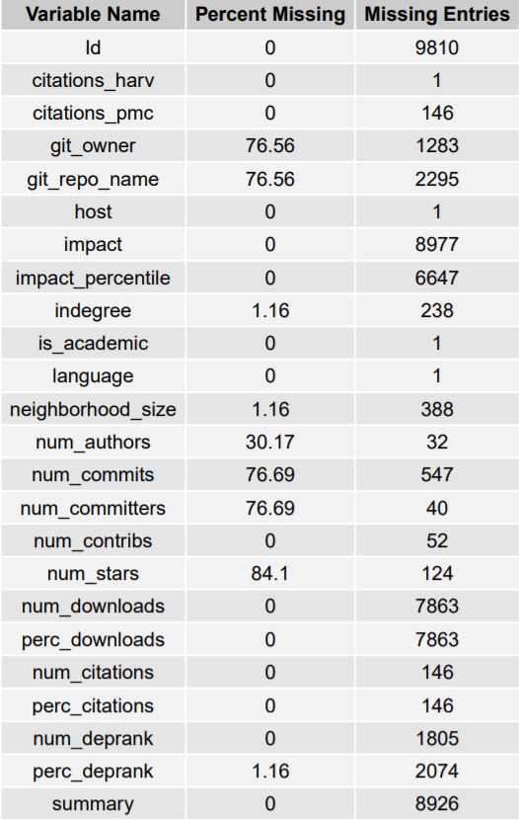
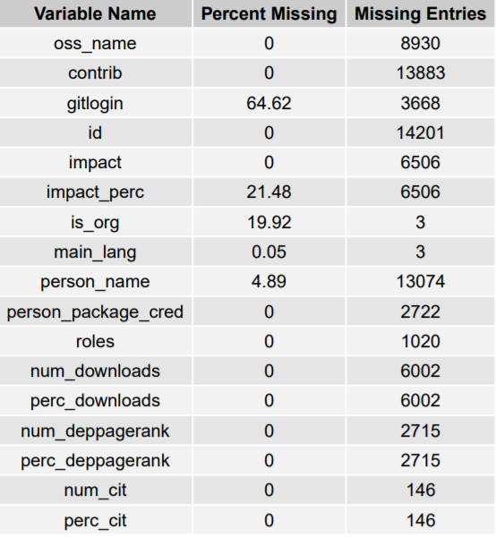
Data Completeness Tables for Contributor and Package Matrices

Slide 62
Data Completeness Tables for Contributor and Package Matrices

Slide 63
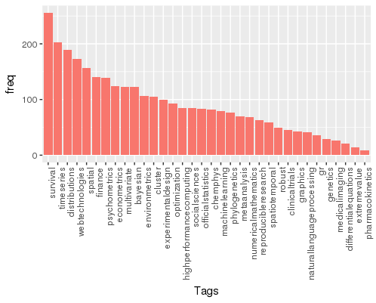
Top Tags by Frequency

